Slide 1



Storage Components of Google Cloud Platform
An Overview of Google Cloud’s Data Storage Services
by Shivsagar N

Slide 2

GCP Storage Overview
Object Storage
Designed for unstructured data like images and videos. Supports scalable and durable storage with global reach.
Block Storage
Persistent storage attached to virtual machines, providing low-latency access for databases and boot disks.
File Storage
Shared file systems using standard protocols, ideal for applications requiring a hierarchical file structure.
Databases
Managed relational and NoSQL databases for structured data, optimized for performance and scalability.

Slide 3

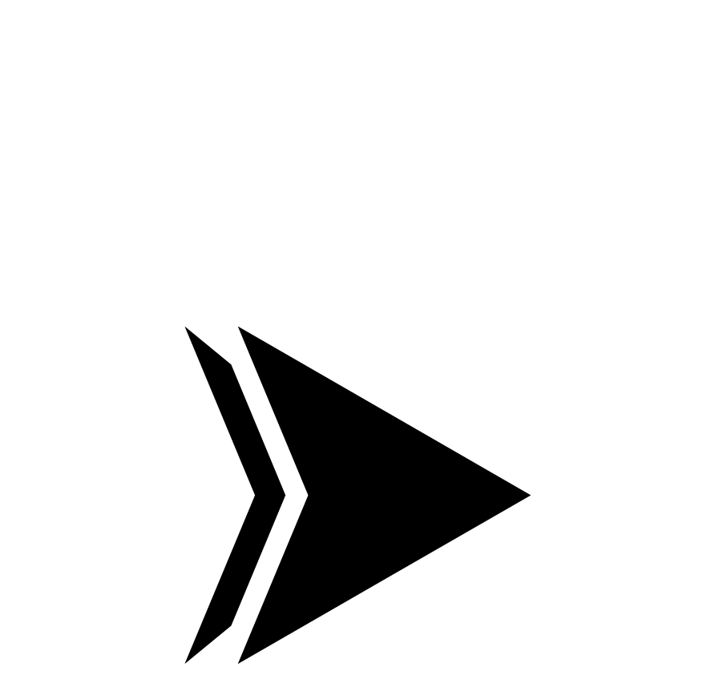
Google Cloud Storage (GCS) – Object Storage
Key Features
11 9’s durability ensures data resilience
Multiple storage classes for diverse needs
Advanced lifecycle management and versioning
Fine-grained IAM and signed URLs for secure access
Use Cases
Backup and archival of critical business data
Storing large media files like images and videos
Data lakes for machine learning datasets and big data

Slide 4

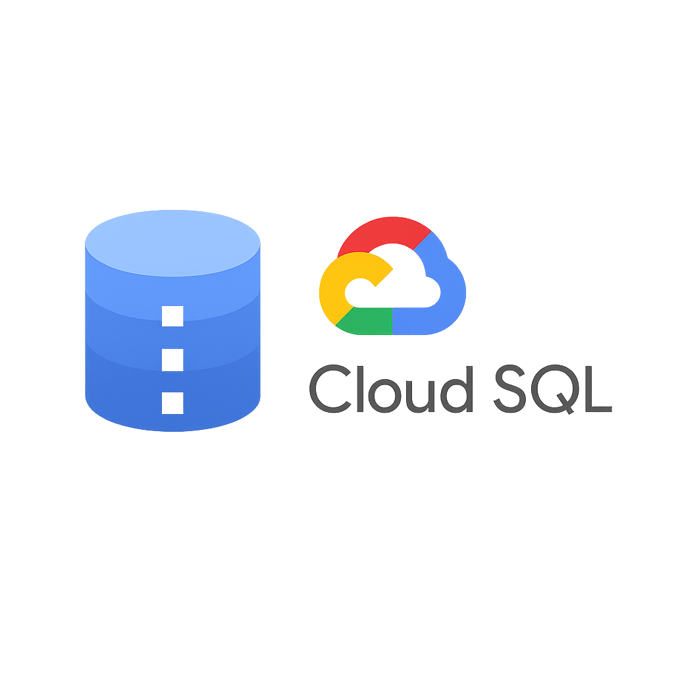

Persistent Disks – Block Storage
Disk Types
Key Features & Use Cases
Standard HDD for cost-effective large capacity
Attachable to Compute Engine VMs for persistent storage
SSD for high IOPS and throughput needs
Snapshots for backup and disaster recovery
Balanced SSD offering a middle ground for performance and cost
Dynamic resizing without downtime
Optimized for databases and boot disks
Persistent Disks

Slide 5

Filestore – File Storage
NFS-based Managed Storage
Tiers
Typical Use Cases
Basic for entry-level performance
Shared file storage for content management systems
Fully managed Network File System service, simplifying file storage for applications.
High Scale for growing workloads
Enterprise for demanding performance and capacity
High-performance computing and media workloads
Applications requiring a POSIX-compliant file system
Filestore

Slide 6

Cloud SQL & Cloud Spanner – Structured Storage
Cloud SQL
Cloud Spanner
Managed relational database supporting MySQL, PostgreSQL, and SQL Server
Globally distributed, horizontally scalable SQL database
Strong consistency across continents
Automatic backups, high availability, and replication features
Suited for large-scale enterprise applications requiring global availability
Ideal for transactional applications and web backends
Cloud SQL & Cloud spanner

Slide 7

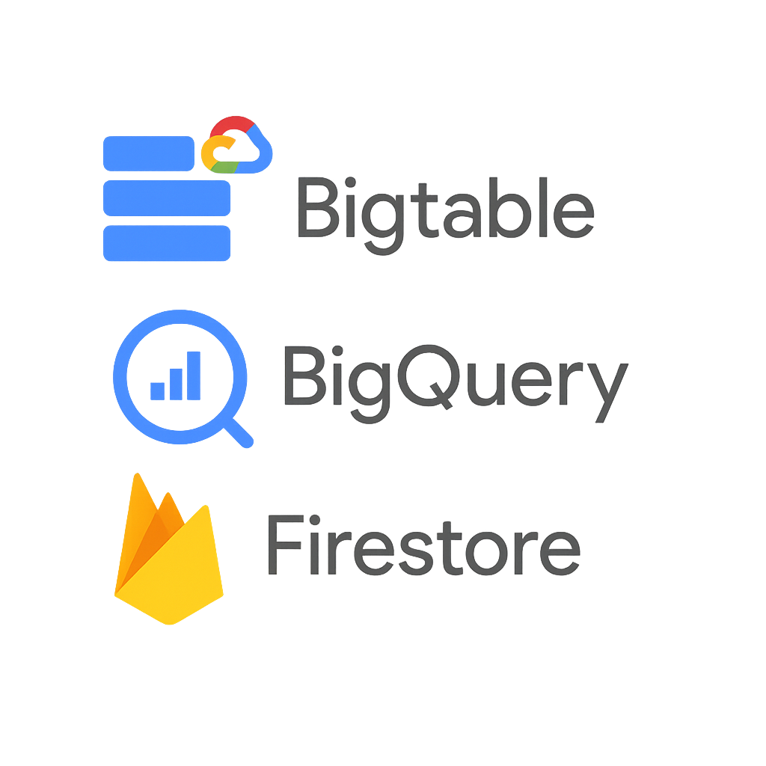
Other Data Storage Services
Bigtable
Firestore / Datastore
NoSQL wide-column store optimized for large analytical and IoT workloads requiring low latency.
Scalable NoSQL document database with real-time synchronization for mobile and web apps.
BigQuery
Serverless, columnar data warehouse designed for fast SQL queries over massive datasets.

Slide 8

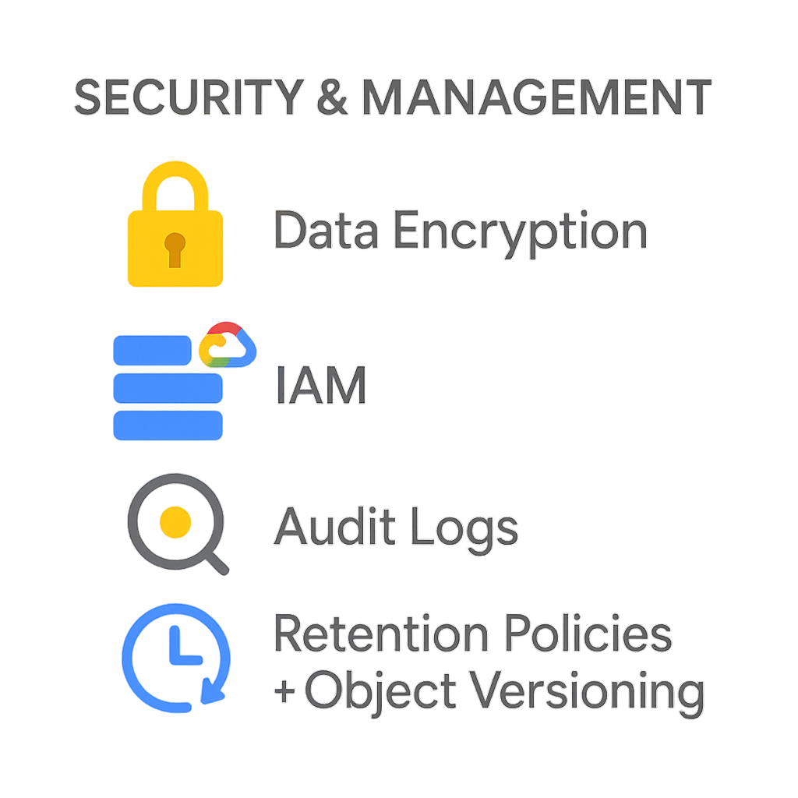
Security & Management in GCP Storage
Data Encryption
Access Control
Audit & Compliance
Retention & Versioning
Automatic encryption of data at rest and in transit to protect sensitive information.
Role-based Identity and Access Management (IAM) to secure data and restrict permissions precisely.
Comprehensive audit logging to track data access patterns and support regulatory compliance.
Policies to retain data according to business needs, including object versioning to recover previous states.
Security & Management GCP Storage

Slide 9
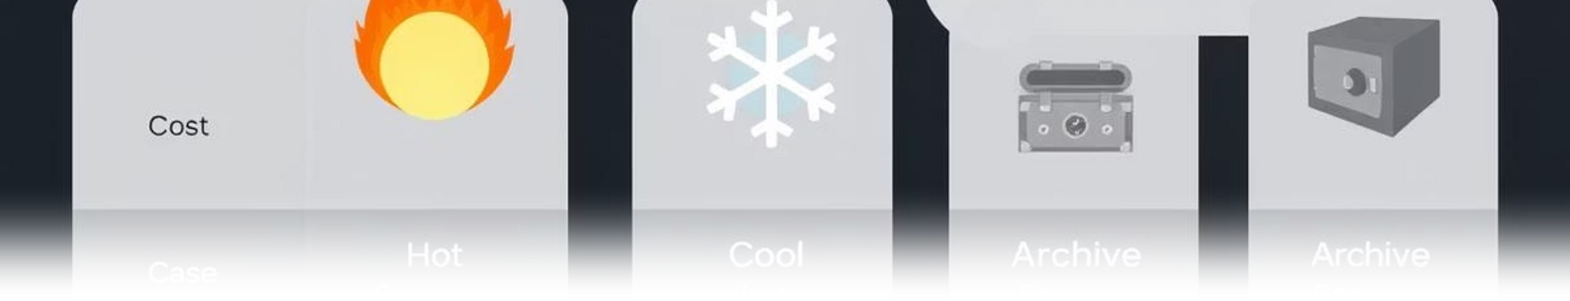
Storage Class Comparison for GCS
Class
Access Frequency
Use Case
Cost
Standard
Frequent
Website hosting, applications
Higher
Nearline
~1/month
Backups
Medium
Coldline
~1/quarter
Archival storage
Low
Archive
Rare (~1/year)
Compliance, long-term retention
Very Low
Storage Class Comparison

Slide 10

Key Takeaways & Next Steps
1
Comprehensive Storage Portfolio
GCP offers object, block, file, and structured storage optimized for diverse workloads.
2
Scalability & Security
Robust scalability with global availability and strong built-in security measures.
3
Choose Based on Use Case
Select storage classes and services that match access patterns, performance, and cost goals.
4
Next Steps
Evaluate workloads and design your storage strategy leveraging GCP’s flexible and integrated services.
Uses based on Requirement

Slide 11



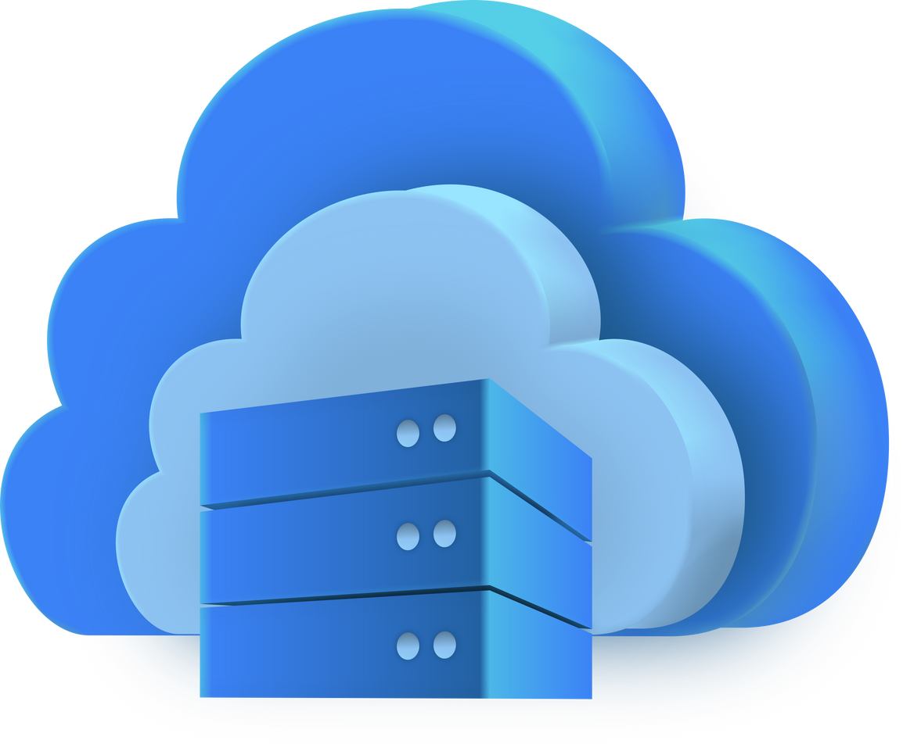


THANK YOU
FOR YOUR ATTENTION
Presented By:
Shivsagar N

